Slide 1
Sexually Transmitted Diseases &
Pelvic Inflammatory Disease
MBCHB IV Lecture
Dr A. Mutungi

Slide 2
Lecture Objectives
At the end of this session, the students will be able to:
State the magnitude of STDs
Differentiate between STDs that cause abnormal discharge and genital ulcer
Discuss clinical presentation and management of some of the common STDs
Discuss PID

Slide 3
INTRODUCTION
STDs/STIs: Affect any of the genital organs in females and males
Magnitude:
Worldwide, at least 250 million new cases of STDs occur each year.
  Trichomoniasis 120 million cases a year
  Chlamydia 50 million cases a year
  Human papilloma virus, gonorrhea, and herpes simplex virus 20-30 million cases a year

Slide 4
Women are at higher risk – Why?
Low status- limits ability to negotiate safer sex, & access to information & health care
Larger vaginal surface area than penis and more vulnerable to infection
STIs often asymptomatic in women
NB: Delivery-related blood transfusions may expose women to HIV & hepatitis B

Slide 5
Aetiology & Common presentation
Abnormal Discharge
Chlamydia
Cervical
Origin
Gonorrhea
Vaginal
Discharge
Herpes
Vaginal
Origin
Candidiasis
Trichomonas
Bacterial Vaginosis

Slide 6
Aetiology & Common presentation (contd)
Genital Ulcer Disease (GUD): Most Common Causes
Syphilis
Chancroid
Herpes
Other Causes:
Trauma
Scabies
Other diseases

Slide 7
MORBIDITY FROM STDs
Chronic lower abdominal pain
infertility,
ectopic pregnancy,
spontaneous abortion,
cervical cancer,
premature rupture of membranes,
preterm delivery.
Perinatal and neonatal infections can cause mental retardation, blindness, low birth weight, stillbirth, meningitis, and death.
The social stigma leads to verbal, emotional, or physical abuse.

Slide 8
MANAGEMENT: HISTORY
dyspareunia,
vaginal discharge,
genital skin lesions,
abnormal vaginal bleeding,
dysuria, genital burning
genital itching,
genital malodour
and lower abdominal or pelvic pain

Slide 9
MANAGEMENT: PHYSICAL EXAMINATION
General examination
Specific systems
  Cardiovascular-Stigmata of syphilitic heart disease
  Abdominal- Pain and tenderness associated with PID
  Neurological- Loss of co-ordination associated with tertiary syphilis
  Musculoskeletal - for joint swelling and redness
The pelvic examination.
  Explain to the patient what is going to be done and ask for permission.
  Visually inspect the external genitalia in good lighting
  Speculum exam with water lubrication only
  Bimanual examination

Slide 10
MANAGEMENT: INVESTIGATIONS
pH of the secretions
microscopy Gram stain
Culture and sensitivity
Serologic testing

Slide 11
STD Management - general
Diagnosis
Treatment or referral
Four Cs:
    Counseling
    Condoms
    Compliance with treatment
    Contacting partners of the infected

Slide 12
MANAGEMENT: TREATMENT
Syndromic approach
  Vaginal discharge:
    Treat for candidiasis and trichomoniasis
    if no response treat for gonorrhoea.
    If no response investigate
  Genital ulcer:
    If recurrent and multiple manage as herpes simplex palliative.
    If painless manage as syphilis.
    If multiple painful manage as chancroid
Etiologic approach
  Identify causative agent and treat

Slide 13
Gonorrhea
Most common STD in the world
Etiology:
  Neisseria gonorrhoeae gram negative diplococcus
  affects mucosal surfaces of urethra, endocervix, rectum and pharynx
  cause of female infertility from pelvic inflammatory disease

Slide 14
Gonorrhea
Other Features
Transmission: sexual
Incubation period: 2-7 days
May be asymptomatic in men and women but mostly in women

Slide 15
Gonorrhea: Symptoms
Men:
  Urethral discharge with dysuria, frequency
Women:
  Vaginal discharge
  Dysuria
  Intermenstrual bleeding
  Lower abdominal pain

Slide 16
Gonorrhea: Clinical Signs
Men:
  -Urethral discharge (milk urethra)
  -Discharge is white or yellow; sometimes mucoid
Women:
  -purulent or mucopurulent endocervical exudate (mucopurulent cervicitis)
  -urethral purulence (Skene’s or Bartholin glands)

Slide 17
Gonorrhea: Clinical Signs (contd)
Women (contd)
Cervix mucopurulent discharge from cervical os
Purulence = yellow colour on swab
Cervical ectopy = exposed endocervical mucosa
Friability = Bleeding of cervix when swabbed
Cervical tenderness: tenderness with excitation

Slide 18
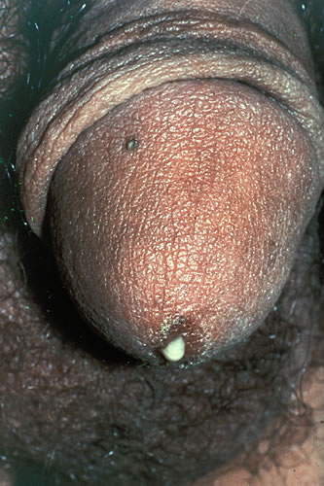

Slide 19
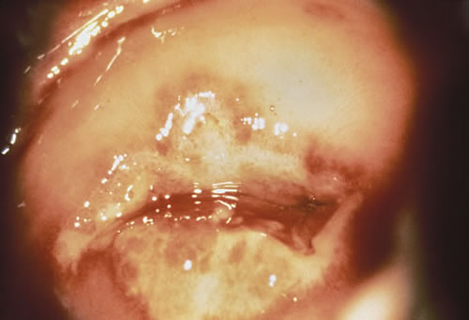

Slide 20
Gonorrhea: Diagnosis
Gram smear:
  gram negative diplococcus
Culture:
  Test of choice; collect swab directly from:
    Urethra: insert swab gently 1-2 cm. into the urethra and rotate slowly.
    Cervix: first remove external vaginal secretions from cervix then insert swab into cervix and rotate and allow 5 seconds for absorption.

Slide 21
Gonorrhea: Treatment
GC - resistant to penicillin
Concurrent anti chlamydial treatment should be given to all patients with GC
Uncomplicated GC:
-Ciprofloxacin 500mg PO single dose (not in pregnancy )
or
-Azithromycin 2 g PO single dose

Slide 22
Chlamydia
Etiology:
  Chlamydia trachomatis
Effects:
In male:
  Uncomplicated - non-gonococcal urethritis (NGU)
  Complicated – infection of epididymis, testes, urethral abscess ± strictures

Slide 23
Chlamydia (contd)
Effects (contd):
In female:
  Uncomplicated – cervicitis, dysuria, mild vulval itchness
  Complicated – symptomatic or asymptomatic PID
  In pregnancy – endometritis; can result in PROM, preterm labor, postpartum PID
In neonate – ophthalmia neonatorum, pneumonia
Incubation period 7-14 days

Slide 24
Chlamydia: Treatment
Doxycycline 100mg PO BD for 7 days
or
Azithromycin 1g PO single dose
Alternative therapies – include:
Erythromycin 500mg PO QID for 7 days
Tetracycline 500mg PO QID for 7 days

Slide 25
Syphilis
Etiology:
-Treponema pallidum
Transmission:
-Sexual during early stages
Stages:
  -Primary, secondary and tertiary
Incubation 3 weeks (10-90 days)
Serologic tests positive in 1-2 weeks

Slide 26
Syphilis: Symptoms
Primary syphilis:
-Single, oval, painless ulcer with clean base
-Usually on external genitalia
-Can be intravaginal or perianal
-Lymph nodes: bilateral, firm, non tender without erythema
Heals spontaneously in 4 weeks

Slide 27
Syphilis: Symptoms
Secondary Syphilis
-Generalized rash, non pruritic
-Involves palms of hands and soles of feet
-Mucous membrane patches
-Genital/perianal warts
-Patchy alopecia
-Generalized lymphadenopathy
-Fever, headache, malaise

Slide 28
Syphilis: Symptoms
Tertiary Syphilis
Occurs from 10-25 years from initial infection
Lesions of the heart & great vessels, brain; due to granulomatous non-infectious gummas involving the tissue organ

Slide 29
Syphilis: Diagnosis
VDRL
Rapid Plasma Reagin (RPR) - a nontreponemal test
  -Measures non specific antibody. May be false positives
Treponemal pallidum hemagglutinationation (TPHA)
  -Not used for screening
  -Used for confirmation of positive RPR (to identify false positives)
  -Also used in the diagnosis of late syphilis when RPR may be negative

Slide 30
Syphilis: Treatment
Primary, secondary and early latent
-Benzathine penicillin G 2.4 million units IM single dose
Alternative: Pen allergic
-Doxy 100mg PO bid X 2 weeks
or
-Tetracycline 500mg PO qid x 2 weeks
Contact tracing

Slide 31
Syphilis: Treatment
Late syphilis: > 1 year duration
-Benzathine penicillin G 2.4 million units weekly X 3 weeks
Contact tracing and treatment

Slide 32
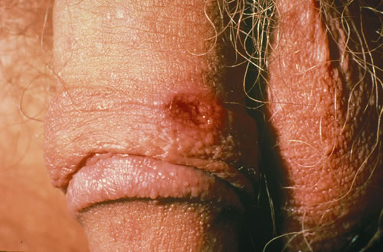

Slide 33
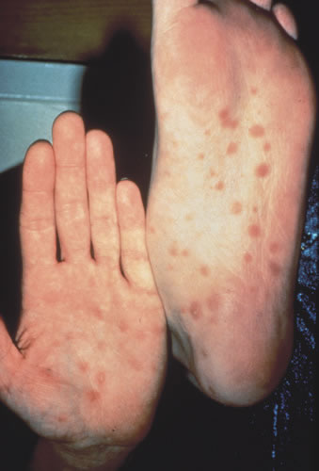

Slide 34
Chancroid
Etiology: Haemophilus ducreyi
Transmission: sexual contact
Other features: Chancroid ulcer
  increases HIV transmission

Slide 35
Chancroid Symptoms
Symptoms:
  -Painful ulcer (may be multiple)
  -Painful inguinal lymphadenopathy in 50%
  -Lymph nodes may be fluctuant and may rupture

Slide 36
Chancroid Treatment
Azithromycin 1.0 g single dose
or
Ciprofloxacin 500 mg bid X 3 days
or
Erythromycin 500 mg PO QID X 7days
Contact tracing
Needle aspiration of fluctuant lymph node

Slide 37
Pelvic Inflammatory Disease (PID)
Usually a disease of sexually active women
Results from ascending infection from lower genital tract
Involves endometrium (endometritis), fallopian tubes (salphingitis), ovaries (oophoritis) ± peritoneum (peritonitis)
Results from STI mainly gonorrhea and chlamydia; secondary invasion may follow – from anaerobic bacteria, E.Coli, Klebsiella, Streptococci, Staphylococci

Slide 38
PID: Diagnosis
Diagnosis:
  Early cases may be asymptomatic
  Acute disease may mimic other causes of acute abdomen
  Gynecologic and surgical history very important
NB: Any gyne Hx-ABCD (A-Any pain, B-Bleeding, C-Contraception/Children/Coitus, D-Discharge

Slide 39
PID: Diagnosis (contd)
Criteria for diagnosis:
History of lower abdominal pain
Examination:
  Lower abdominal tenderness ± rebound tenderness
  Tenderness with motion of cervix or uterus

Slide 40
PID: Diagnosis (contd)
Criteria for diagnosis (contd):
Examination:
  Adnexal tenderness + one of the following;
    ↑Body temperature (>38°C)
    Leucocytosis (>10,000/mm)
    Purulent material from peritoneal cavity on culdocentesis or paracentesis
    Pelvic abcess or inflammatory complex on bimanual palpation or ultrasonography
    Elevated ESR
    Lab test - Intracellular diplococci on endocervical swab

Slide 41
PID: Complications
Recurrent or chronic PID
Infertility
Ectopic pregnancy
Chronic pelvic pain
Tubo-ovarian abcess

Slide 42
PID: Treatment
Outpatient:
  Norfloxacin 800mg PO stat, Doxycycline 100mg BD x 7 days and Metronidazole 400mg TDS x 7 days
In-patient:
  Cocktail- X-pen 2MU iv QID, Gentamycin 80mg iv TDS and Metronidazole 500mg iv TDS for 48hrs (or acute symptoms subside), then Amoxycillin 500mg PO TDS and Metronidazole 400mg PO TDS for 7 days
Other regimens (in case of resistance)
  Cefoxitin & Doxycycline for 48 hrs, then Doxycycline for 10-14 days
  Clindamycin & Gentamycin for 48 hrs, then Doxycycline or Clindamcin for 10-14 days

Slide 43
Prevention of STDs & PID
Education
Counseling
Contraceptive choices – availability
Condom use
Treatment of infected (to avoid infection of others)
Male involvement

Slide 44
Thank you

